Slide 1
Lesson 7 Malicious Codes (Malware)

Slide 2
Outline
What is a malware?
Common types of malware
How to detect & prevent them?

Slide 3


What is a malware?
A malware is a set of instructions that run on your computer and make your system do something that an attacker wants it to do.
Malware can be classified into several categories, depending on propagation and concealment.

Slide 4
What is a malware?
Propagation
Virus: human-assisted propagation
Worm: automatic propagation without human assistance
Concealment
Rootkit: modifies operating system to hide its existence
Trojan: provides desirable functionality but hides malicious operation
Various types of payloads

Slide 5
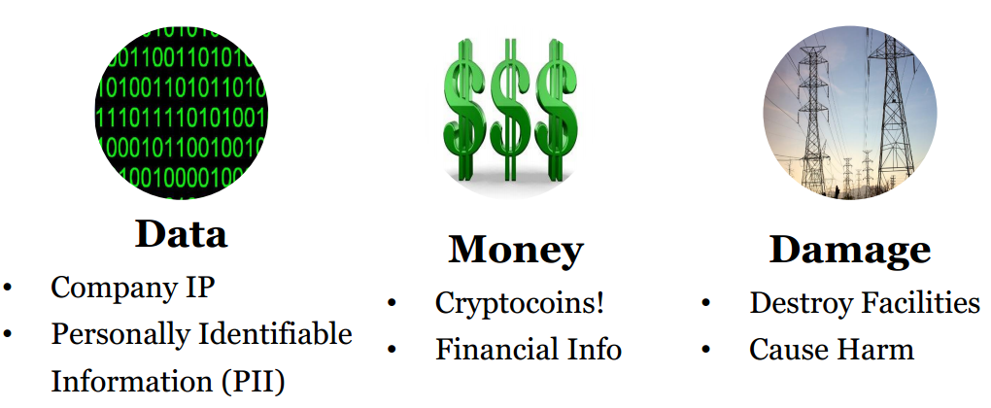
Malware Goals

Slide 6
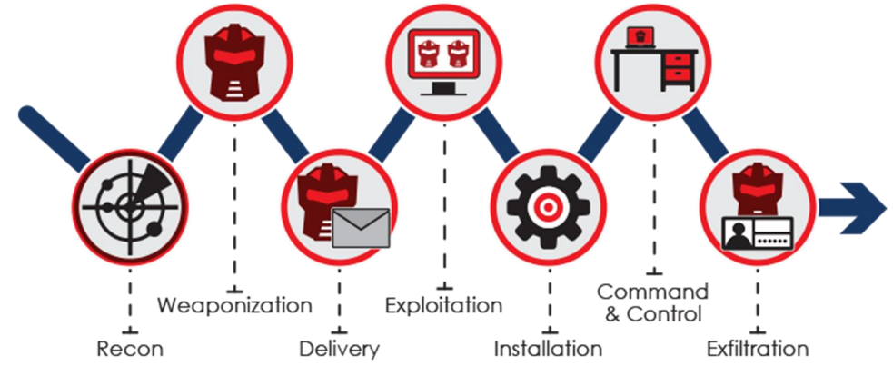
Delivery & Techniques

Slide 7
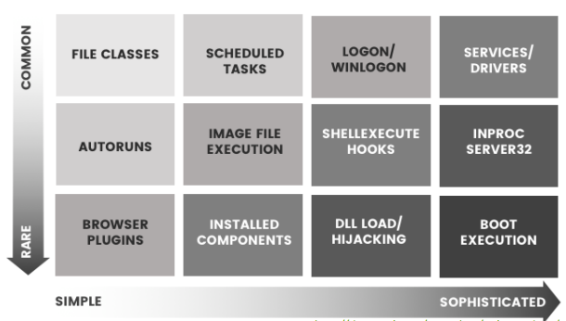
Delivery & Techniques

Slide 8
Malware Types
Basic types:
Virus
Worms
Trojan Horse
Several variants of the basic types exist:
Time Bomb
Logic Bomb
Keylogger
Rootkit
Adware
Spyware
…

Slide 9
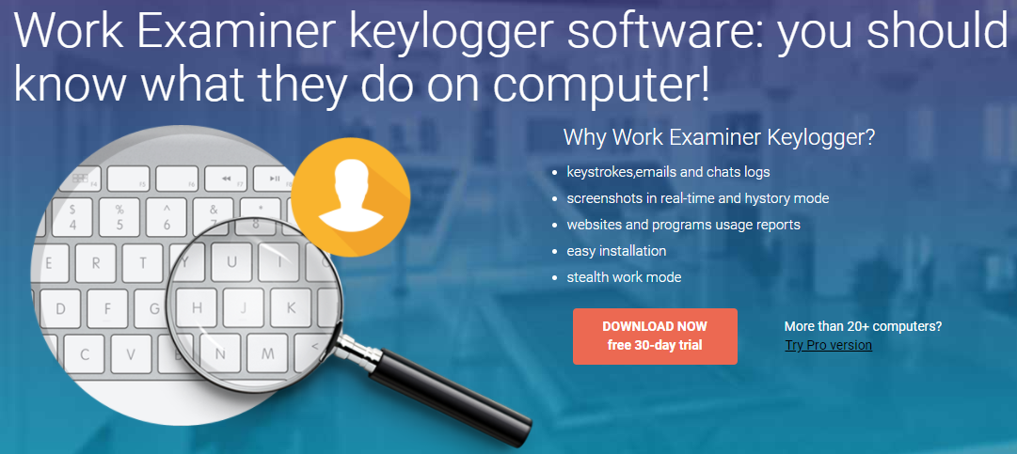
Keylogger

Slide 10
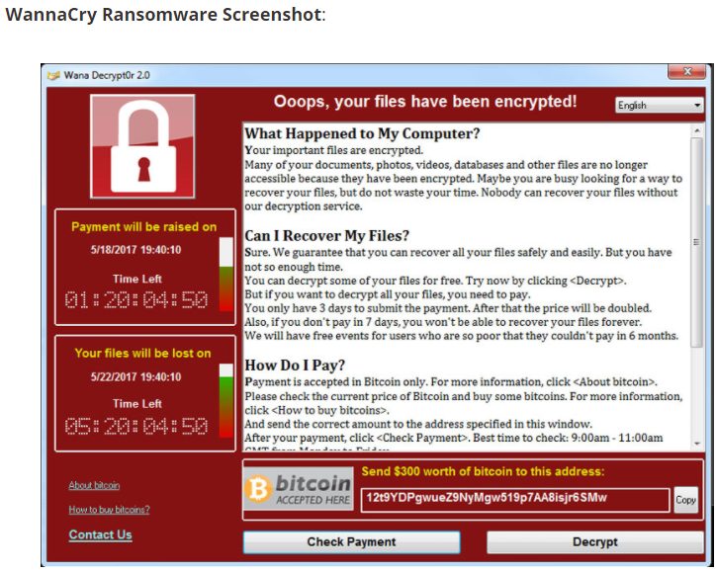

Slide 11
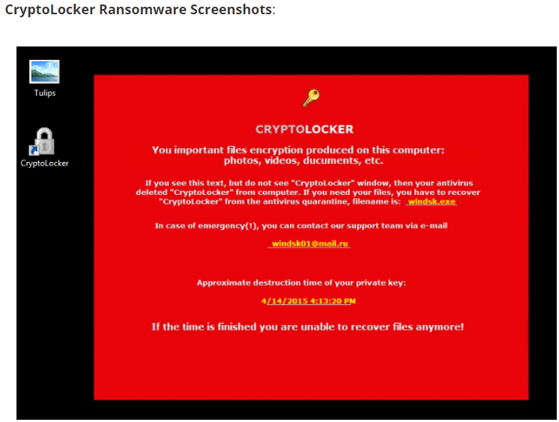

Slide 12
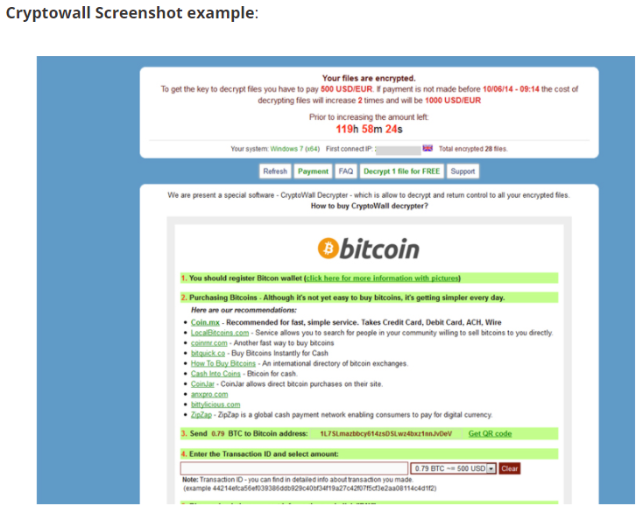

Slide 13
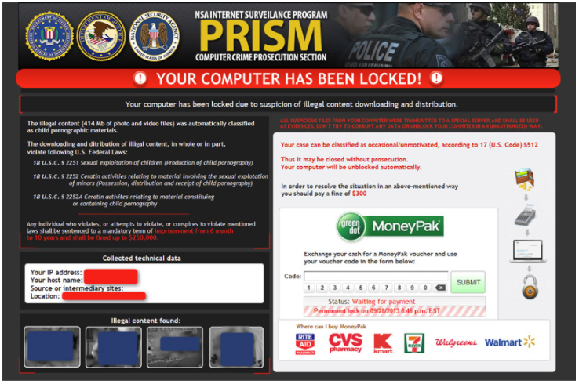

Slide 14
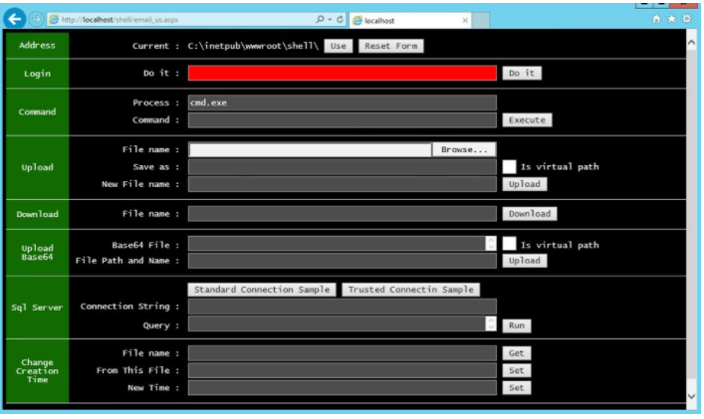

Slide 15
Computer Virus
Virus: a program that attaches copies of itself into other programs.
Propagates and performs some unwanted functions
Viruses are not programs
Definition from RFC 1135: A virus is a piece of code that inserts itself into a host [program], including operating systems, to propagate. It cannot run independently. It requires that its host program be run to activate it.

Slide 16

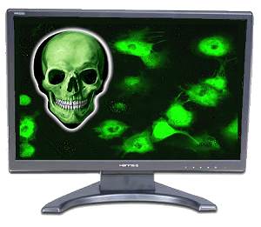
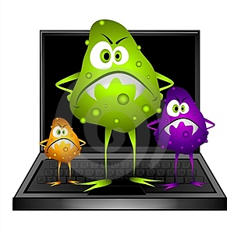
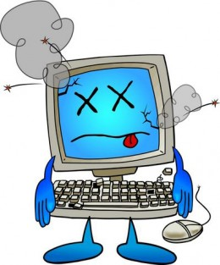
Four Phases of a Virus
The virus is activated to perform the function for which it was created
1. Dormant Phase
3. Triggering Phase
2. Propagation Phase
4. Execution Phase
The virus is idle
Not all viruses have this stage
the virus places an identical copy of itself into other programs of into certain system areas
The function is performed
The function may be harmless or damaging

Slide 17
Virus Types
Parasitic virus – ký sinh:
Attaches itself to a file and replicates when the infected program is executed
most common form
Memory resident virus:
lodged in main memory as part of a resident system program
Virus may infect every program that executes

Slide 18
Virus Types
Boot Sector Viruses:
Infects the boot record and spreads when system is booted
Gains control of machine before the virus detection tools
Very hard to notice
Macro Virus:
virus is part of the macro associated with a document

Slide 19
Virus Types
Stealth virus
A form of virus explicitly designed to hide from detection by antivirus software
Polymorphic virus:
A virus that mutates with every infection making detection by the “signature” of the virus difficult
Mutate: đột biến

Slide 20
How Viruses Append
+
virus
=
virus
Original
program
Original
program
Virus appended to program

Slide 21
How Viruses Append
+
virus
=
Virus-1
Original
program
Original
program
Virus-2
Virus surrounding a program

Slide 22
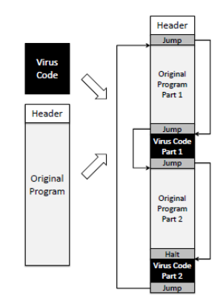
How Viruses Append
Virus integrated into program

Slide 23
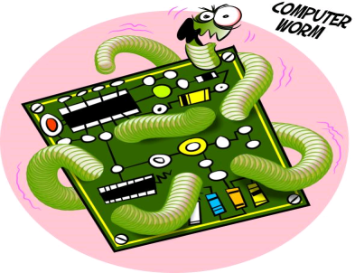
Computer Worms
A computer worm is a malware program that spreads copies of itself without the need to inject itself in other programs, and usually without human interaction.
In most cases, a computer worm will carry a malicious payload, such as deleting files or installing a backdoor.

Slide 24
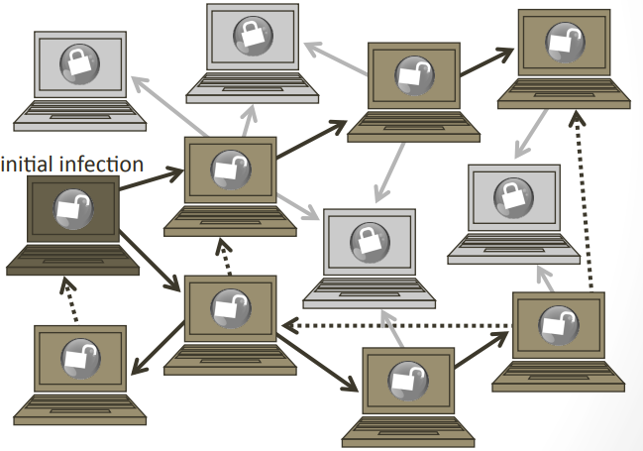
Worm Propagation
Worm propagation by finding and infecting vulnerable hosts

Slide 25
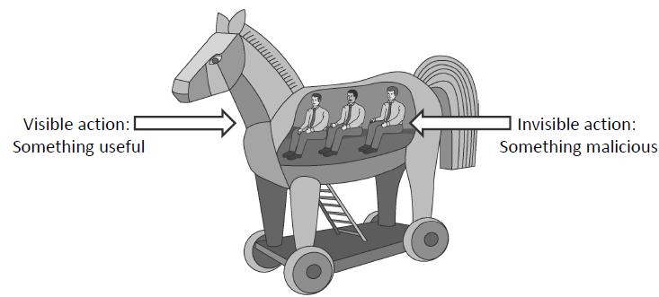
Trojan Horses
A Trojan horse is a malware program that appears to perform some useful tasks, but which also does something with negative consequences.

Slide 26
Logic/Time Bomb
programmed threats that lie dormant for an extended period of time until they are triggered
When triggered, malicious code is executed

Slide 27
Rootkit
Rootkit: Rootkits are designed to conceal certain objects or activities in your system. Often their main purpose is to prevent malicious programs being detected – in order to extend the period in which programs can run on an infected computer

Slide 28
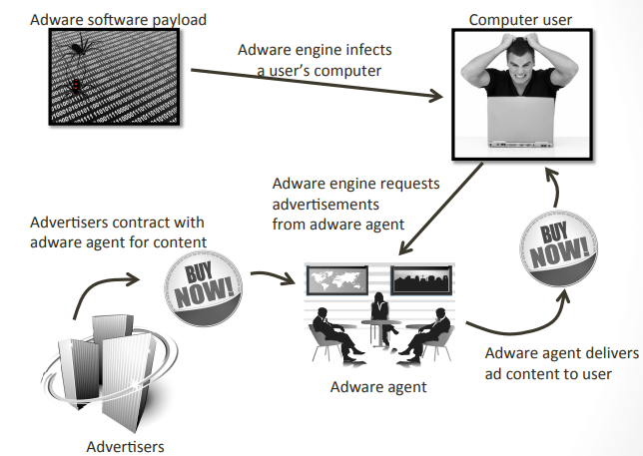
Adware

Slide 29
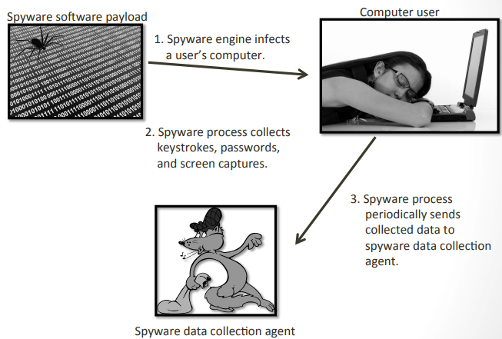
Spyware
Software which sends information to its creators about a user's activities (e.g., passwords, credit card numbers, and other information that can be sold on the black market.

Slide 30
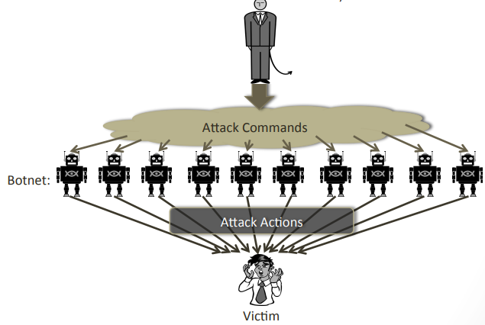
Malware Zombies
Malware can turn a computer into a zombie, which is a machine that is controlled externally to perform malicious attacks, usually as a part of a botnet.

Slide 31

Where does Malicious Code Hide?
1. Email
2. Web Content
3. Legitimate Sites
4. File Downloads
….

Slide 32


How to detect & prevention them
A detection system may detect suspicious activities.
A prevention system must identify and stop malicious attacks before they do damage and have a chance to infect a system.

Slide 33
Malware Countermeasures
Signatures
Find a string that can identity the virus
Heuristics Analysis -
Useful to identify new and “zero day” malware
Analyze program behavior (network access, file open, attempt to delete file, attempt to modify the boot sector,…)
Heuristic methods can trigger false alarms
Sandbox analysis
Running the executable in a VM
Observe it (file activity, network, memory,…)
White/Black listing

Slide 34
Signatures
Scan compare the analyzed object with a database of signatures
A signature is a virus fingerprint (E.g., a string with a sequence of instructions specific for each virus )
A file is infected if there is a signature inside its code (Fast pattern matching techniques to search for signatures)
All the signatures together create the malware database that usually is proprietary

Slide 35
Antivirus Approaches
Detection
determine infection and locate the virus
Identification
identify the specific virus
Removal
remove the virus from all infected systems, so the disease cannot spread further
Recovery
restore the system to its original state

Slide 36
Preventing Virus Infection
Prevention:
Good source of software installed
Isolated testing phase
Use virus detectors
Limit damage:
Make and retain backup copies important resources

Slide 37
Preventing Malicious Attacks on the Internet
Up-to-date
Install a firewall
Scanning systems

Slide 38
Malware analysis
There are two fundamental approaches to malware analysis
Static analysis, which involves examining and analyzing the malware without executing it
Dynamic analysis, which involves executing the malware on the system and analyzing it.

Slide 39
Q & A

